Slide 1
A study on the challenges faced by remote teams to manage software projects in Bangladesh.

Slide 2
Presented By
Md. Reaz Uddin Chowdhury (21-92155-3)
Ummey Soaiba Yeasmin (21-92158-3 )
Akibur Rahman Akib (22-92573-2 )
Sheuly Akter (22-92609-2)
Md. Rifat-Uz-Zaman (22-92610-2 )

Slide 3
Table of Content
Keywords
Abstract
Introduction
Research questions
Background
Methodology
Results & Discussion
Conclusion
References

Slide 4
Keywords
Agile
Software Project management
Remote work
Remote project management

Slide 5
Abstract
Adopt agile based iterative approach for software development.
Agile emphasizes constant collaboration with stakeholders.
During covid-19 pandemic, software projects manage remotely.
Agile framework is challenging.
Employees believe working remotely.
Communication with colleagues more difficult.

Slide 6
Introduction
Waterfall doesn’t allow teams to deal with the increasing complexity
Rapid changes in requirement
Lack of user involvement
Unrealistic expectations by stakeholders
Poor communication and planning
Spiral method acceptable but not suitable
Agile methodologies remotely claim to solve challenges

Slide 7
Research questions
What are the challenges that teams have faced after switching to remote work?
How teams have adapted to remote work?
Have agile methodologies been useful in a fully remote setting?

Slide 8
Background
1990s, adoption was human interactions-focused approach
2001, Agile comes with shared principles
Mid 1990, Extreme Programming (XP), Scrum, extreme Testing, and Crystal Family of Methodologies, Dynamic Systems Development Method (DSDM), Adaptive Software Development (ASD), and Feature-Driven Development (FDD) started
Agile software development techniques grow popularity

Slide 9
Methodology
Used google forms
Create paperless questionnaire
Included software engineers, project managers, business analysts and testers
Take opinion about impact of the remote work
Conducted one-to-one interviews

Slide 10
Results and Discussion
Achieved 50 response
44% are software engineers
14% QA Tester
12 % Business analysts
12 % Project managers
4% other technical leads
Discarded 7 responses

Slide 11
Role id the respondent working as

Slide 12
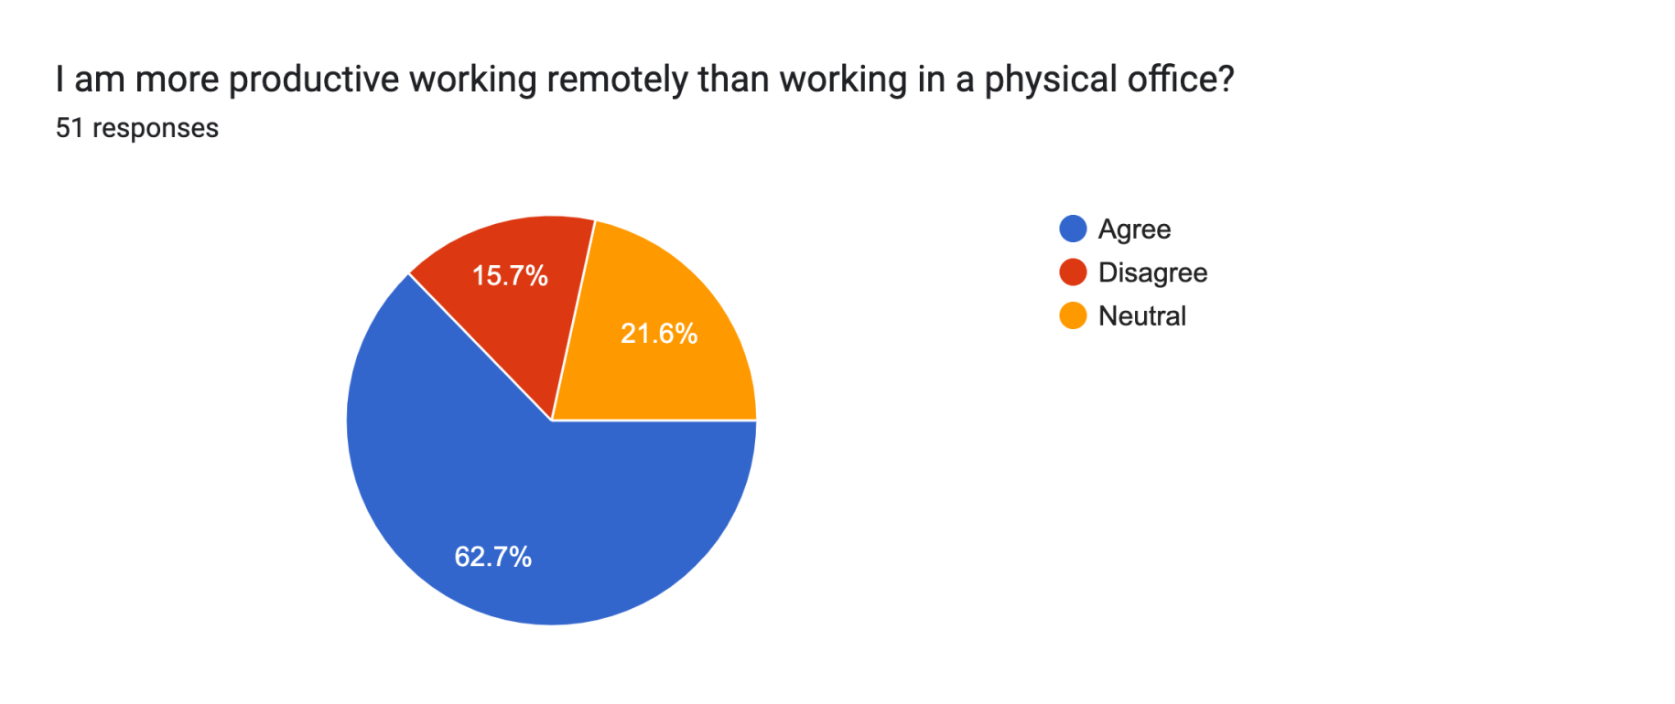
Productivity and Time management

Slide 13
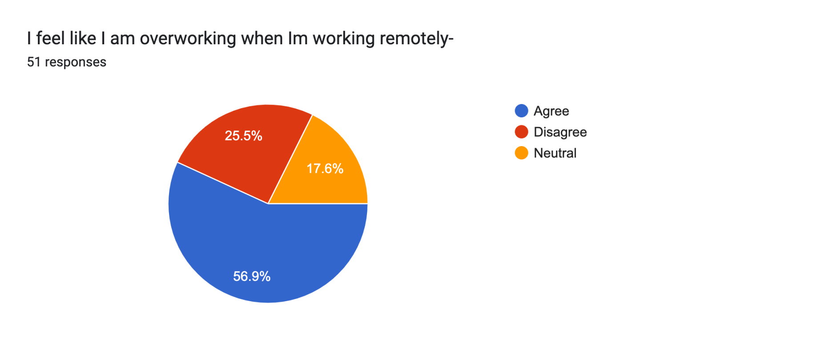
Overworking in the office vs remote work

Slide 14
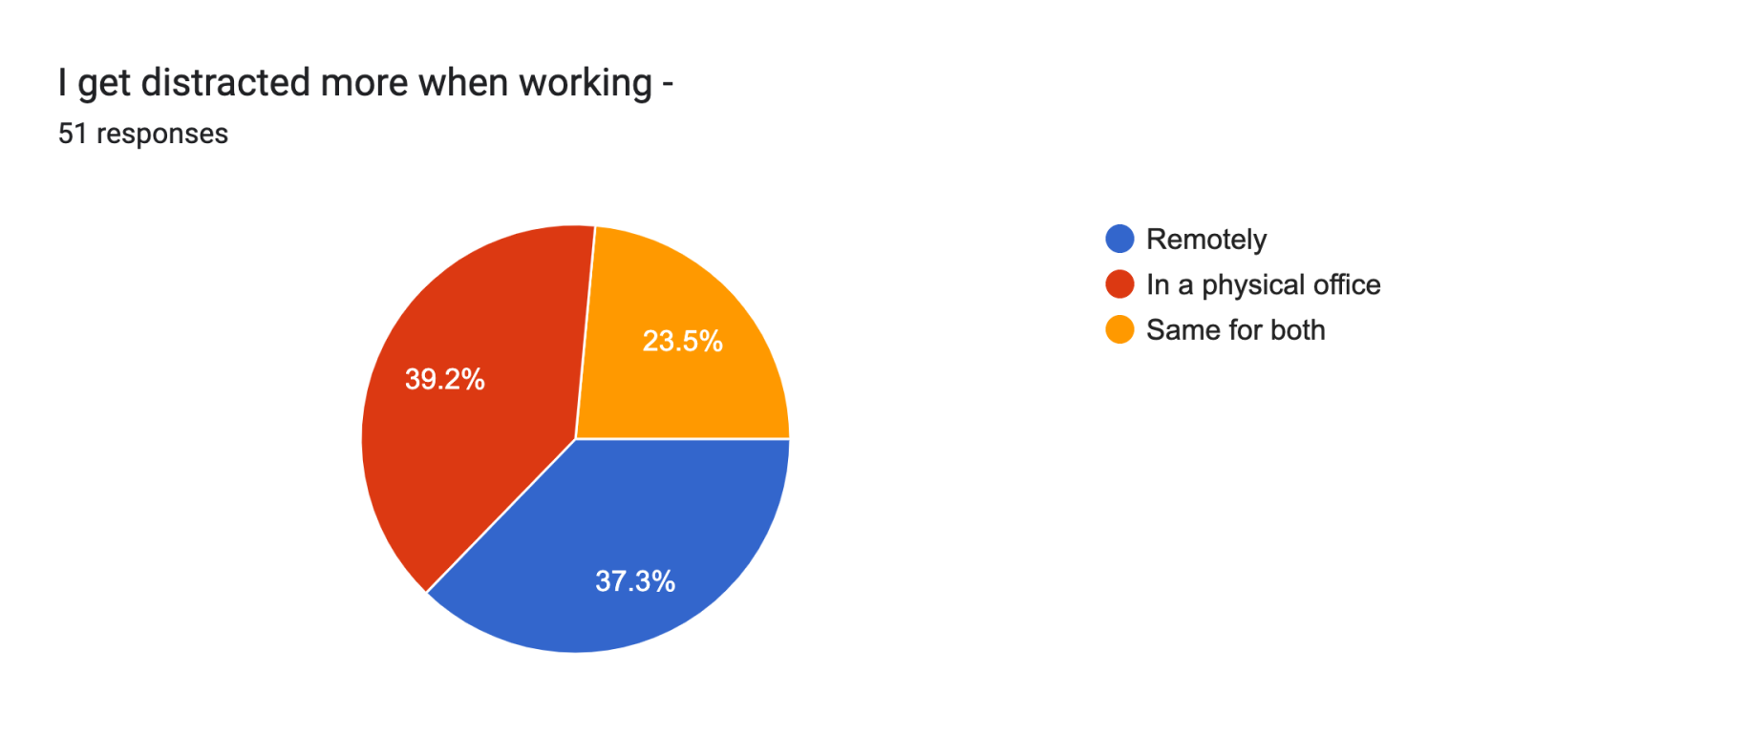
Getting distracted in the office vs remote work

Slide 15
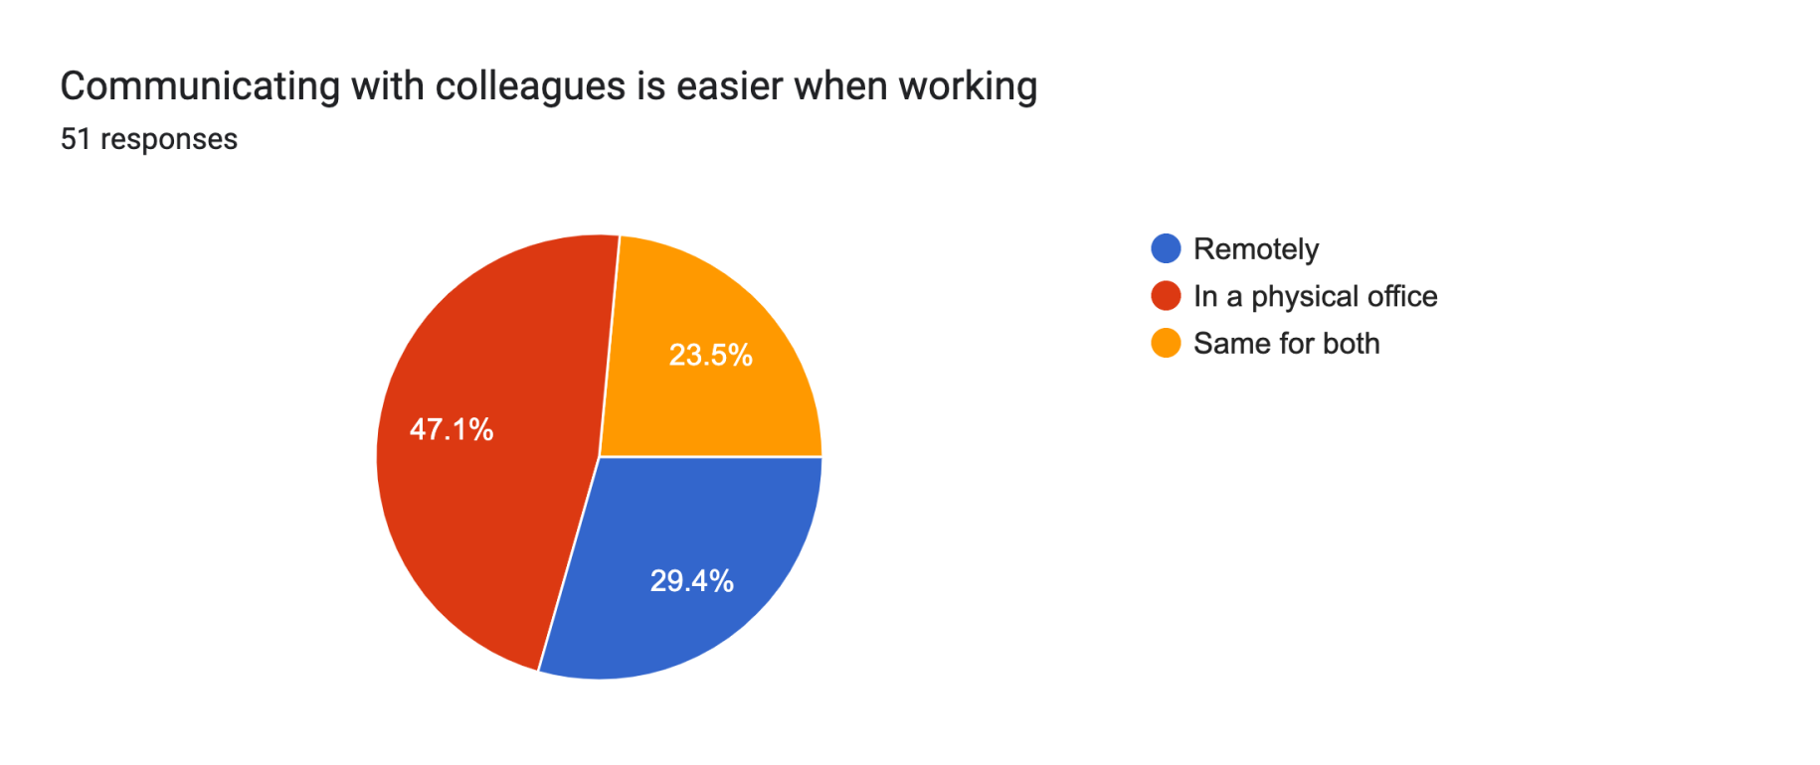
Communication and Support

Slide 16
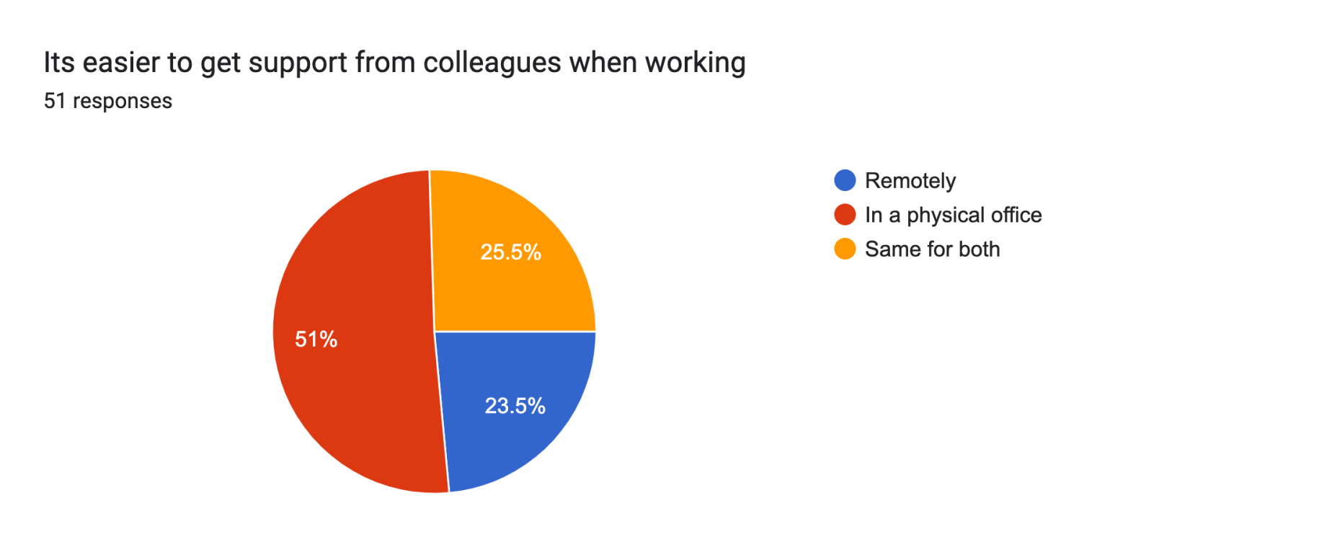
Getting support in the office vs remote work

Slide 17
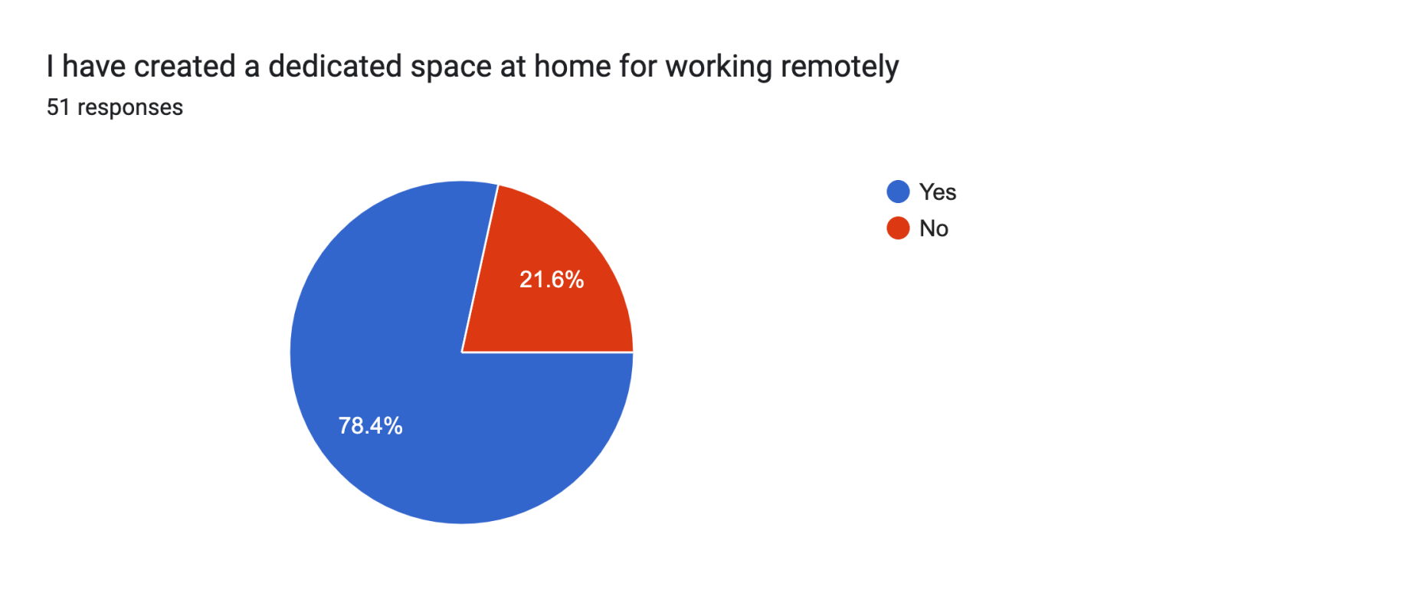
Working environment and setting

Slide 18
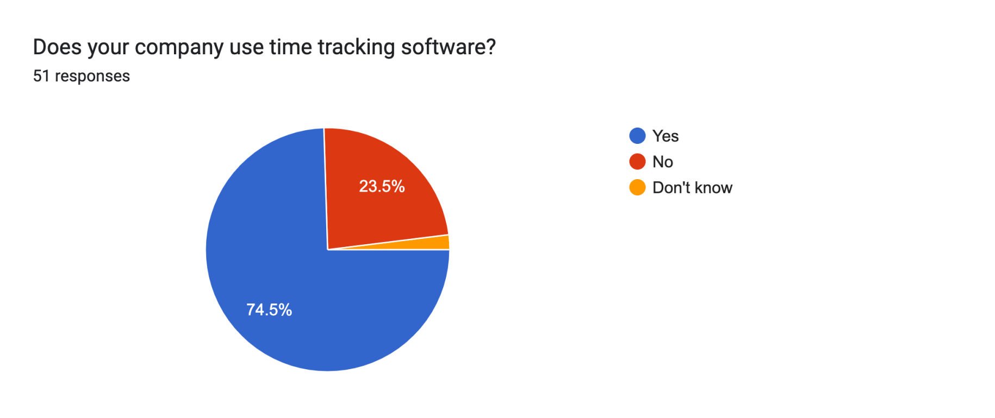
Time tracking software for remote work

Slide 19
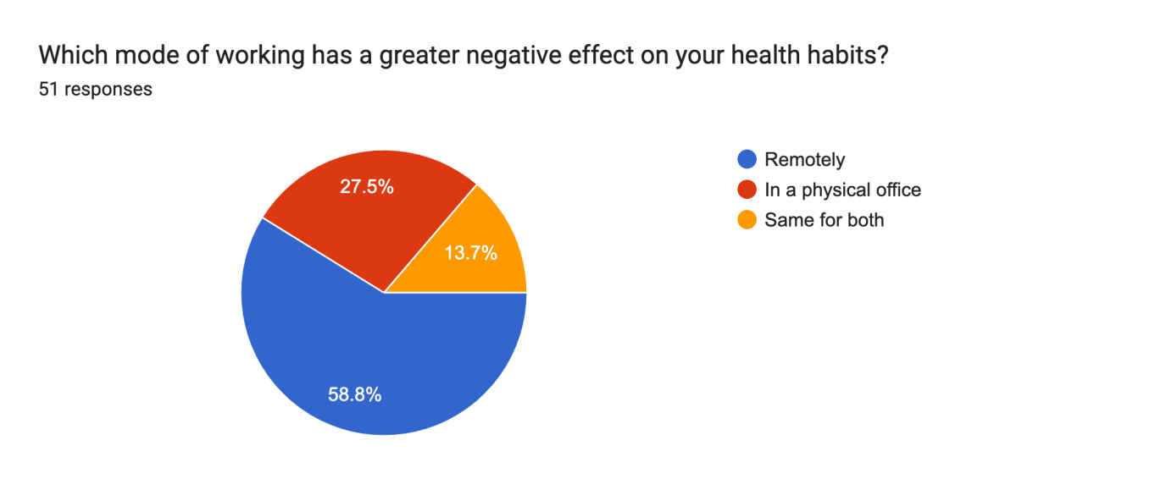
Mode of work which has an effect on health

Slide 20
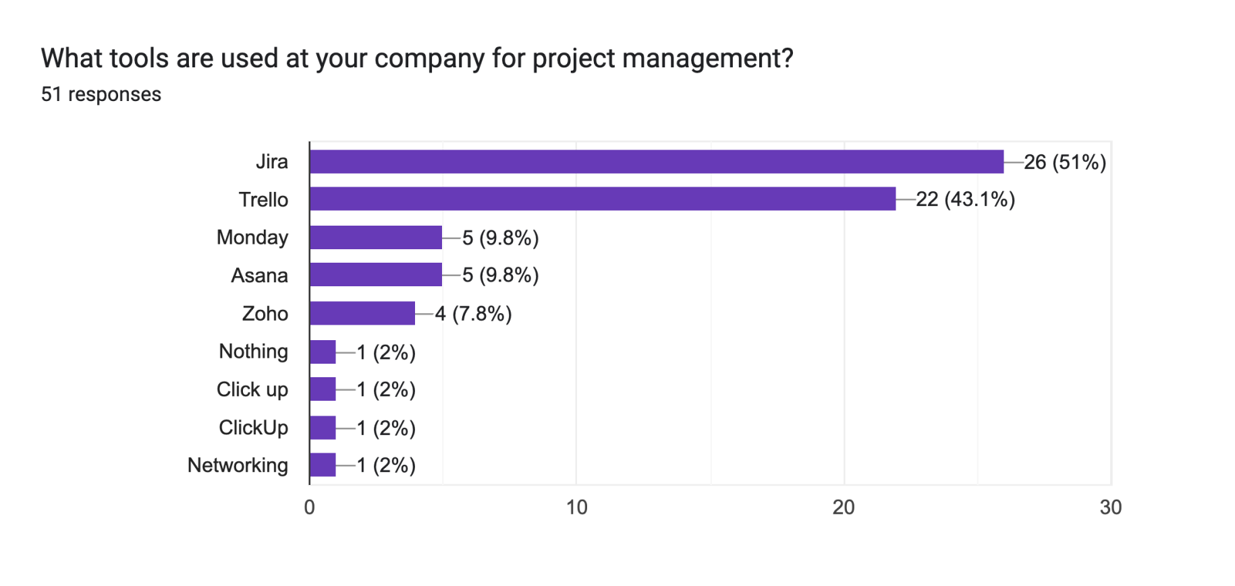
Agile and project management

Slide 21
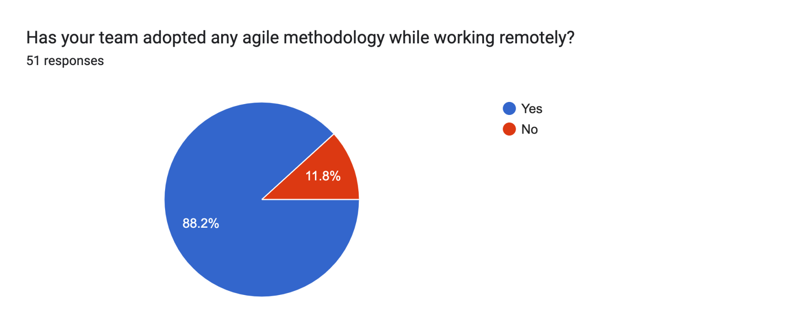
Is your team following an agile methodology?

Slide 22
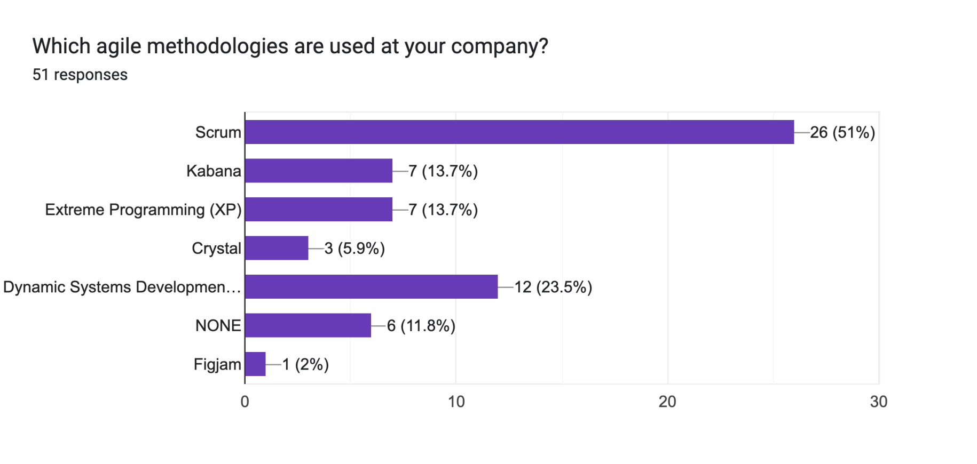
Agile methodology my popularity

Slide 23
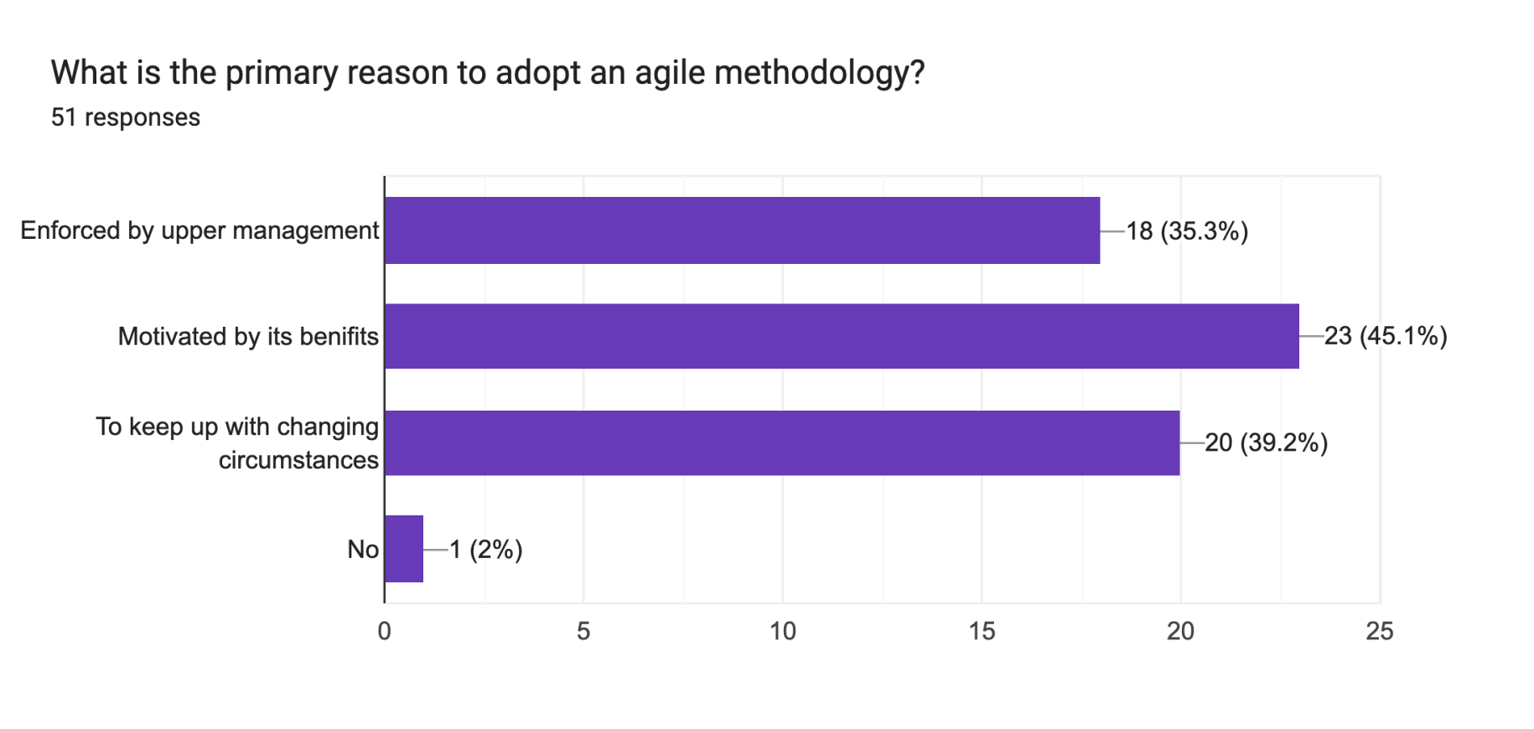
Why adopt agile

Slide 24

Is agile useful for remote teams

Slide 25
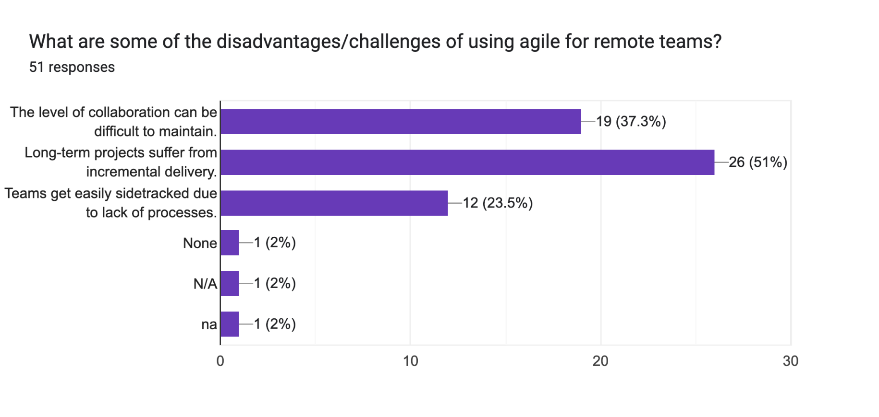
Disadvantages of using agile

Slide 26
Conclusion
Strong result shown
Employees believe working remotely
Increased productivity
Reduced distractions
Face difficult to communicate
Face some difficulty initial phase of remote work
Agile give outstanding outcome remotely.

Slide 27
References
[1] R. N. Charette, "Why software fails [software failure]," Spectrum, IEEE, vol. 42, no. 9, pp. 42-49, September 2005. [Online]. Available: http://dx.doi.org/10.1109/MSPEC.2005.1502528.
[2] In Empirical Software Engineering and Measurement, A. Begel and N. Nagappan published "Usage and Perceptions of Agile Software Development in an Industrial Context: An Exploratory Study" in 2007. First International Symposium on ESEM 2007, pp. 255–264, 2007..
[3] The effects of remote work on collaboration among information workersLongqi Yang, David Holtz, Sonia Jaffe, Siddharth Suri, Shilpi Sinha, Jeffrey Weston, Connor Joyce, Neha Shah, Kevin Sherman, Brent Hecht & Jaime Teevan. https://www.nature.com/articles/s41562-021-01196-4.

Slide 28
Thank You

Slide 29
Any Questions?

